Slide 1



Combining multiple tree rearrangement operators for efficient parsimony inference using reinforcement learning approach
Students: Huỳnh Tiến Dũng, Vũ Quốc Tuấn, Nguyễn Việt Dũng
Science Instructor: TS. Hoàng Thị Điệp
Notes:
Greetings/Good morning esteemed judges, teachers, and everyone present at today's research competition. I would like to present on behalf of our group a summary of the research topic we have conducted. Our research aims to improve the sampling efficiency in the search space of the MPBoot method by integrating the tree bisection and reconnection (TBR) into MPBoot and combining tree transformation using the ant colony optimization algorithm.

Slide 2
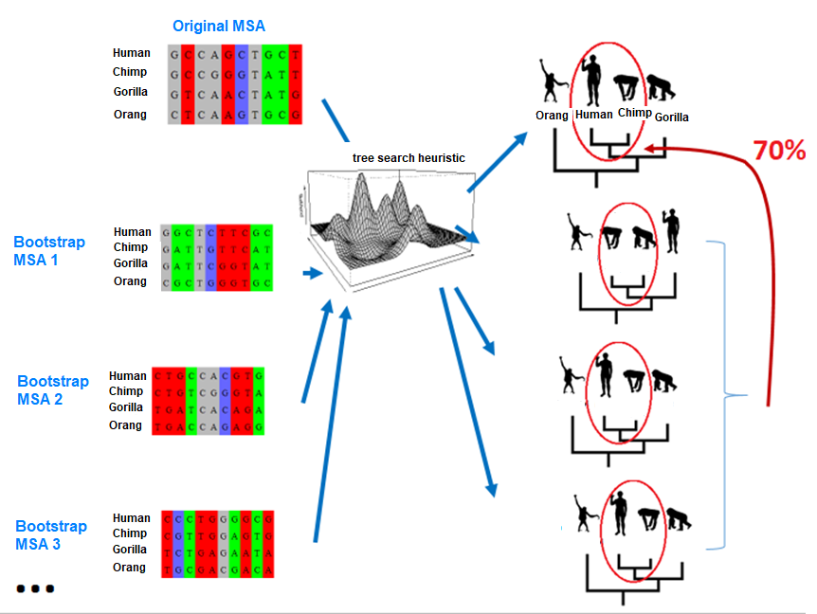
MPBoot
Notes:
MPBoot is a tool for solving the problem of analyzing bootstrap evolutionary trees, which means that in addition to building the evolutionary trees of species, MPBoot also estimates the reliability of the edges in the trees. The strength of MPBoot compared to other tools is that it uses an approximation method, which gives it an advantage in terms of time efficiency

Slide 3
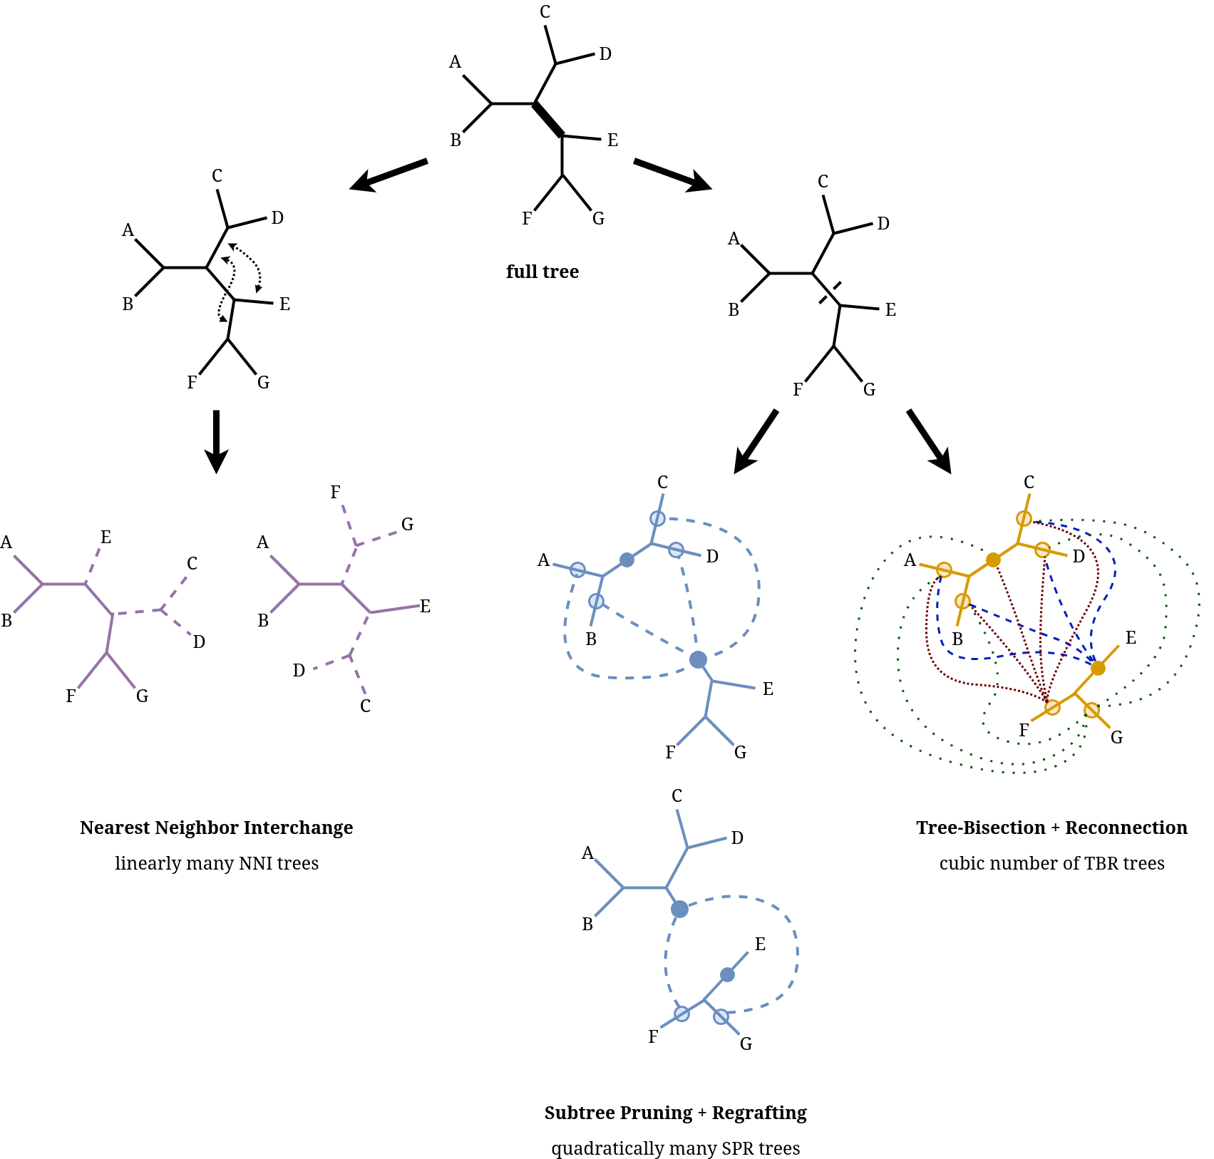
TBR is more comprehensive than SPR, but it has not been integrated into MPBoot yet.
TBR is complex and difficult to implement.
SPR is used throughout the framework of MPBoot
Notes:
Currently, MPBoot only uses the SPR transformation for all phases of the algorithm. Therefore, if we use the TBR transformation comprehensively instead of SPR, it may lead to the creation of more accurate MP trees and bootstrap sets. However, integrating TBR into MPBoot is a challenging and complex task

Slide 4
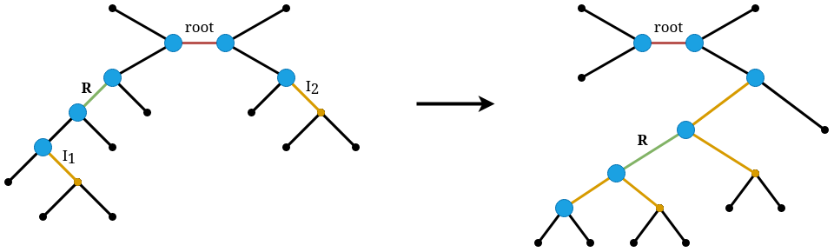
Fast Evaluation of a TBR Move
Best search strategy
MPBoot-TBR-best
Better search strategy
MPBoot-TBR-better
Notes:
As a solution, our group proposes a method for quickly calculating the MP score after 1 TBR operation, along with two search strategies that perform better on hill-climbing, called MPBoot-TBR-best and MPBoot-TBR-better

Slide 5
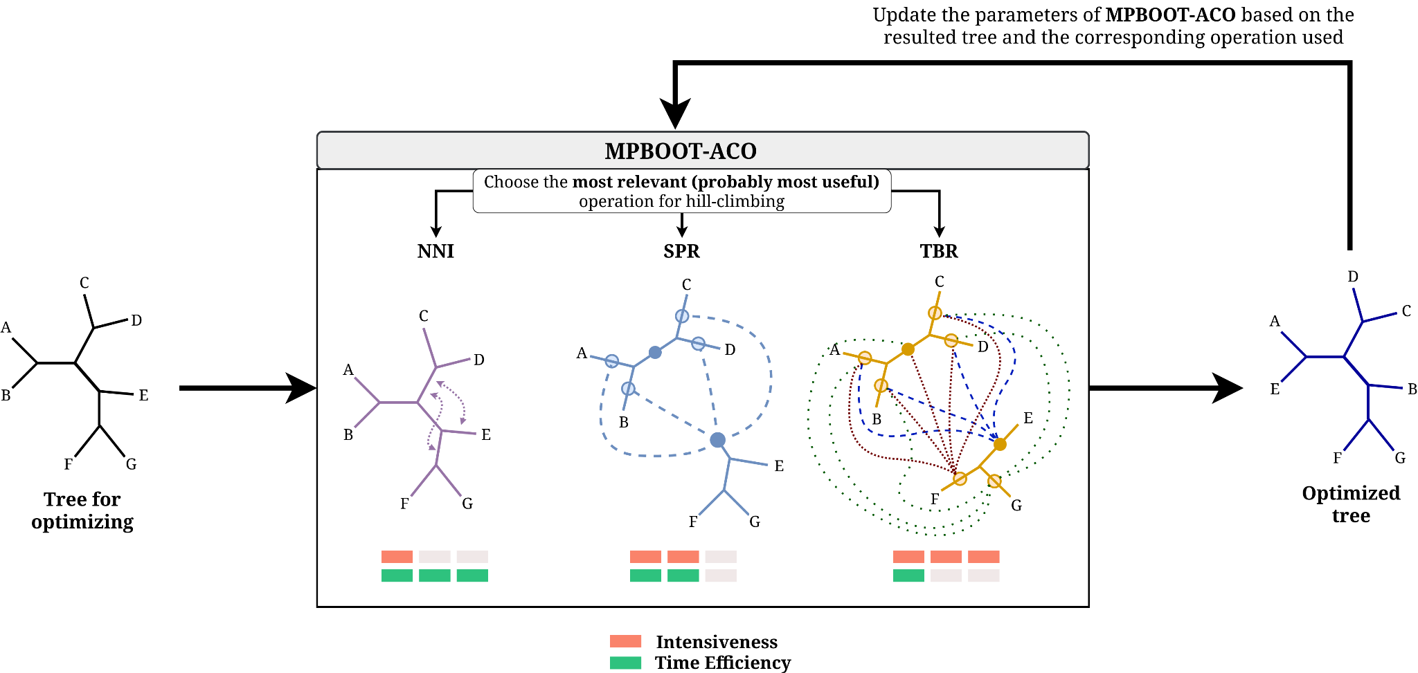
Ant Colony Optimization
Notes:
After successfully integrating the TBR transformation, our group proposes the MPBoot-ACO approach, which combines the three commonly used tree transformations NNI, SPR, and TBR, using an ant colony optimization algorithm to exploit the strengths of each transformation based on the input data.

Slide 6
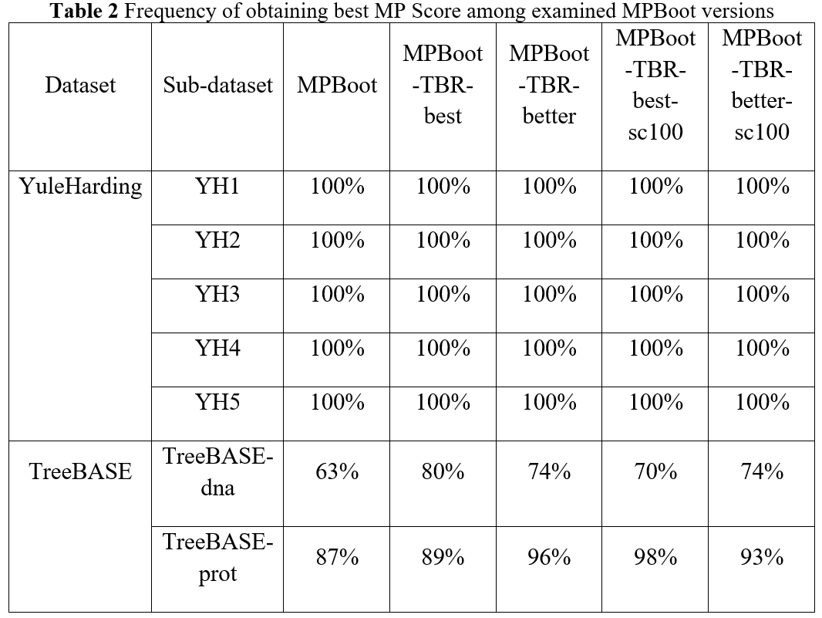

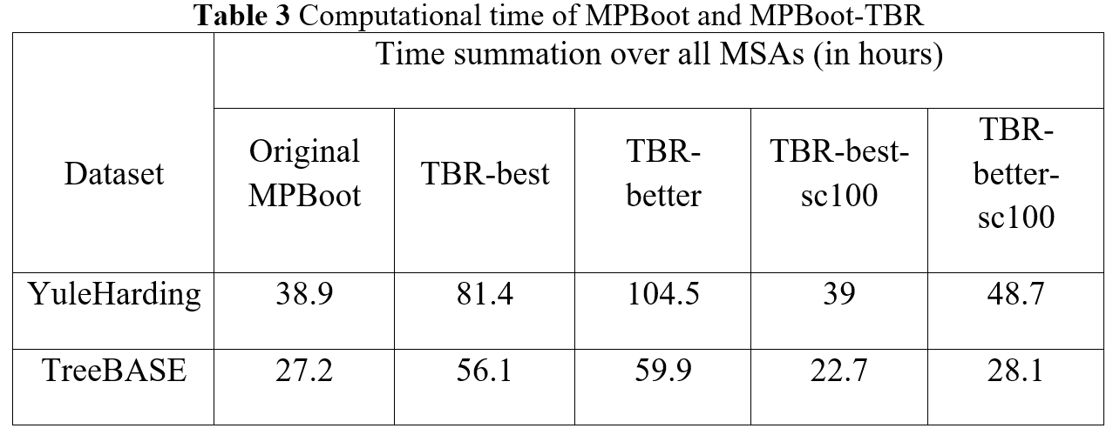
Notes:
Our group has implemented and conducted experiments on the proposed MPBoot-TBR and MPBoot-ACO versions. The results showed that the MPBoot-TBR versions achieved better MP scores than the original version and had comparable processing times.

Slide 7
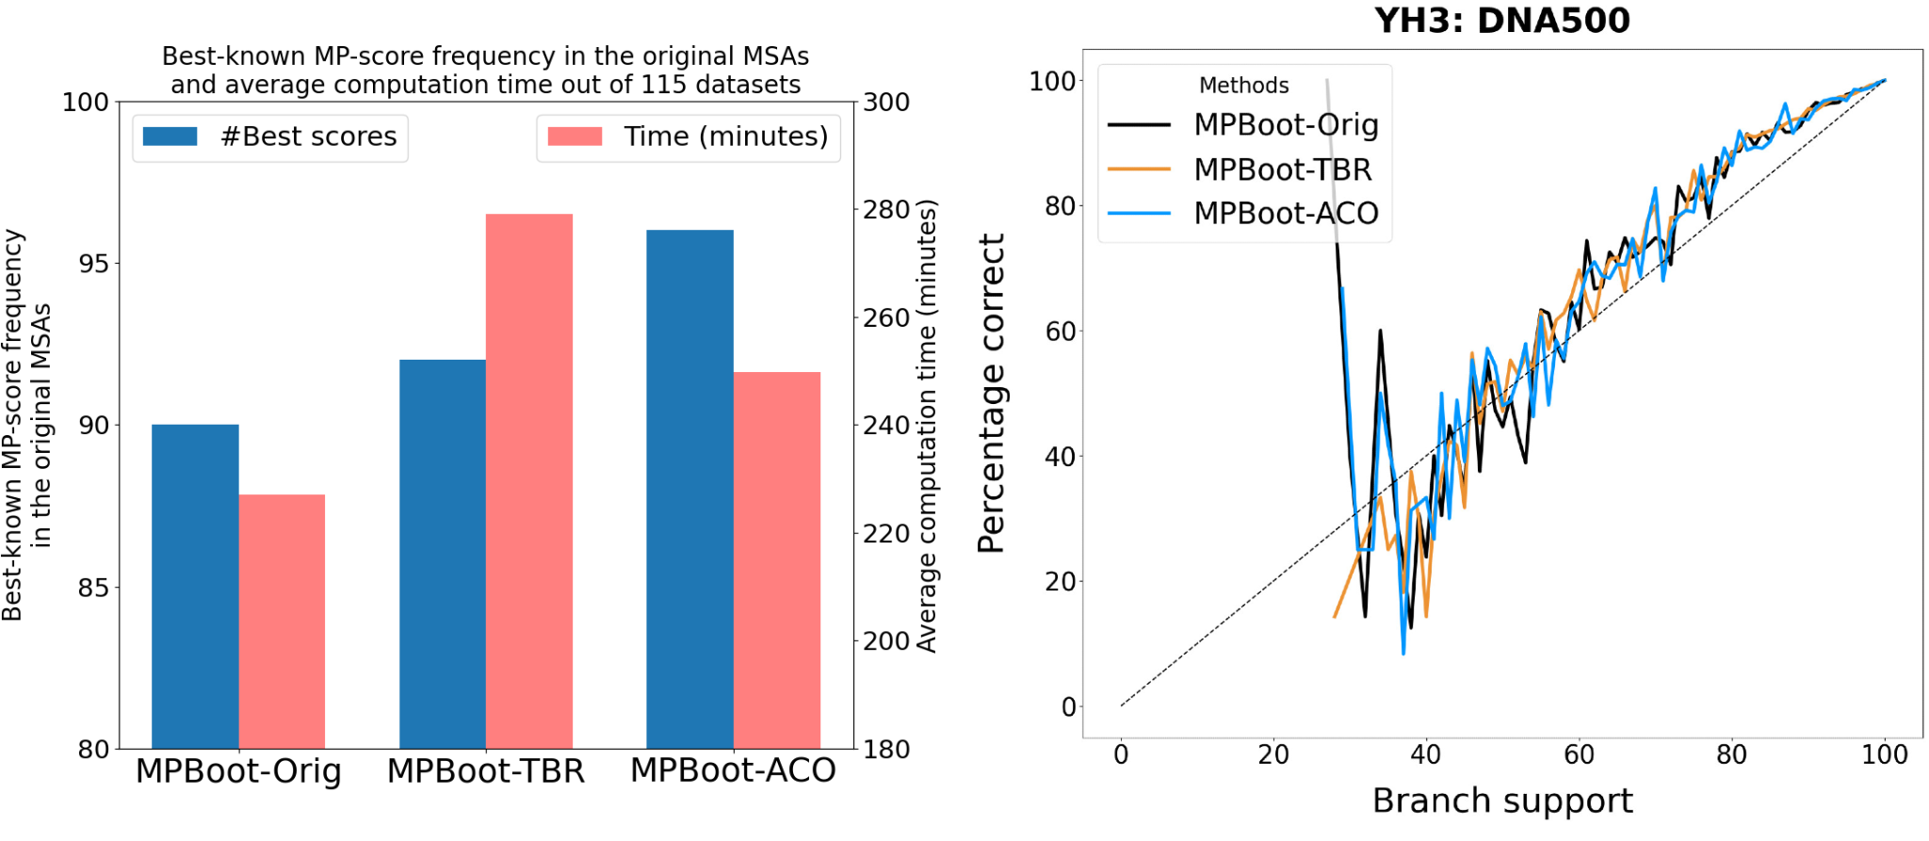
Notes:
The MPBoot-ACO version, which uses the ant colony optimization algorithm, yields better results in terms of MP scores and is faster than MPBoot-TBR.

Slide 8

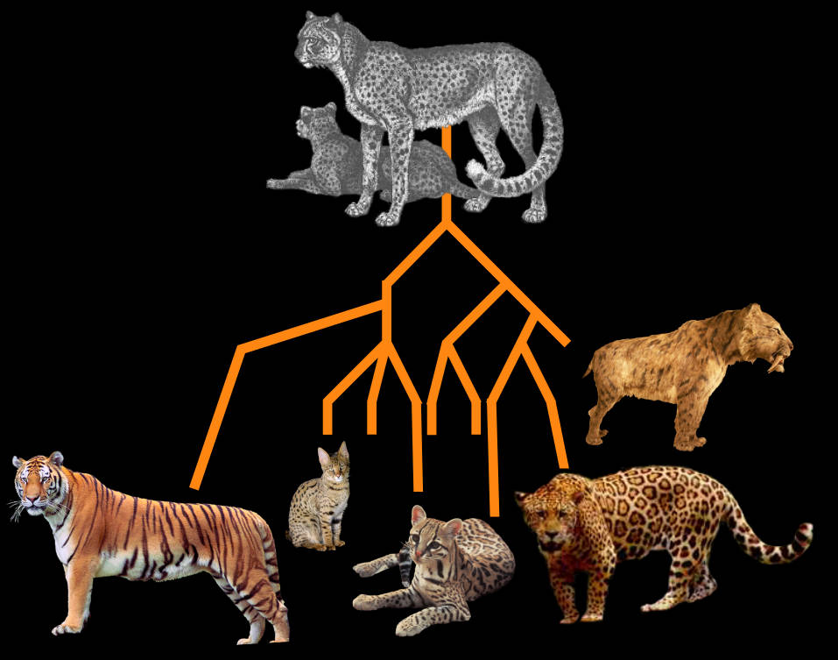



Applications
Notes:
The work of the team can be widely applied in bioinformatics research, as evolutionary analysis is an essential part of many fields such as taxonomy, epidemiology, optimizing DNA editing programs, vaccine research, and choosing animal models for drug testing.

Slide 9
Improved sampling performance
High applicability
Open-source code
Notes:
With improved sampling performance, high applicability and open-source code published, we believe that our work will be widely used in other bioinformatics research.

Slide 10
Thank you for listening
Students:
Science Instructor:
Huỳnh Tiến Dũng - 21020007 - K66C-CLC
Vũ Quốc Tuấn - 21020033 - K66C-CLC
Nguyễn Việt Dũng - 21020043 - K66C-A-CLC2
TS. Hoàng Thị Điệp
Notes:
We sincerely appreciate the conference for their attention and listening.

